Slide 1

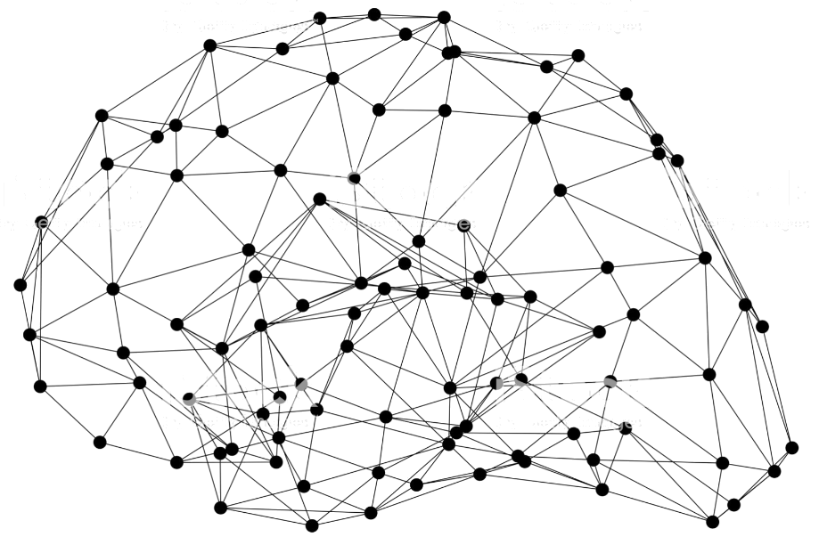
Object Detection using GluonCV
Notes:
First call deck for a high level introduction to Apache MXNet.

Slide 2
Object Detection
Notes:
Due to the popularity and importance in Computer vision, Object detection is one of the earliest applications gluoncv supports.

Slide 3
Highlighted Object Detection Models with GluonCV
Method | Metric | GluonCV | Reference
YOLOv3 | mAP on COCO | 37.0% | 33.0%(paper)
Faster-RCNN-Resnet50 | mAP on COCO | 37.0% | 36.5%(Detectron)
Faster-RCNN-Resnet101-FPN | mAP on COCO | 40.8% | 39.8%(Detectron)
SOTA pre-trained models(single model, single scale test)
Notes:
First I want to highlight some models which achieved higher than reference performance compared to paper or best open source implementations.

Slide 4
Implement SOTA Segmentation Models with GluonCV
Data API
Automated data preparation
Dataset specialized for bbox
Transformation API
Metric API
Loss API
Pre-defined network architectures
Building-blocks
Custom Layers
Reproducible Experiments
Training Script
Configurations
Available in GluonCV

Slide 5
Advanced training approaches included in GluonCV
Label Smoothing
One hot: (0, 1, 0, 0, 0)
Smoothed: (0.01, 0.96, 0.01, 0.01, 0.01)
Prevent overfitting!
[6]Müller, Rafael, Simon Kornblith, and Geoffrey Hinton. "When Does Label Smoothing Help?." arXiv preprint arXiv:1906.02629 (2019)

Slide 6
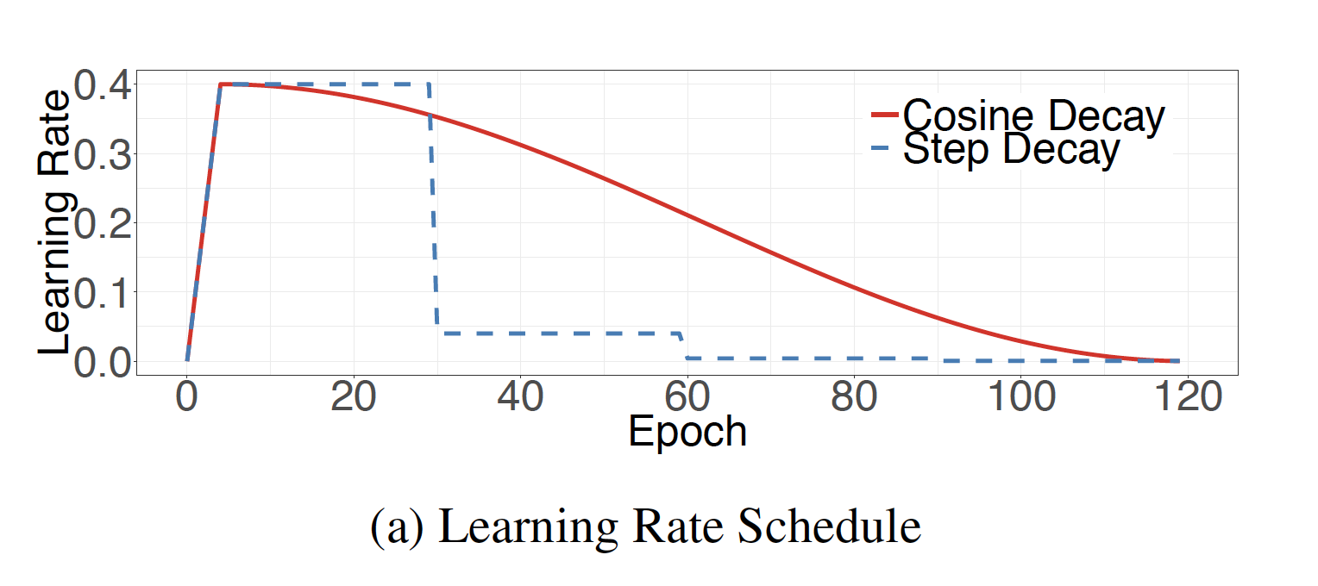
Advanced training approaches included in GluonCV
Learning Rate Schedule
Step
Cosine
Poly
Combine with Warmup

Slide 7
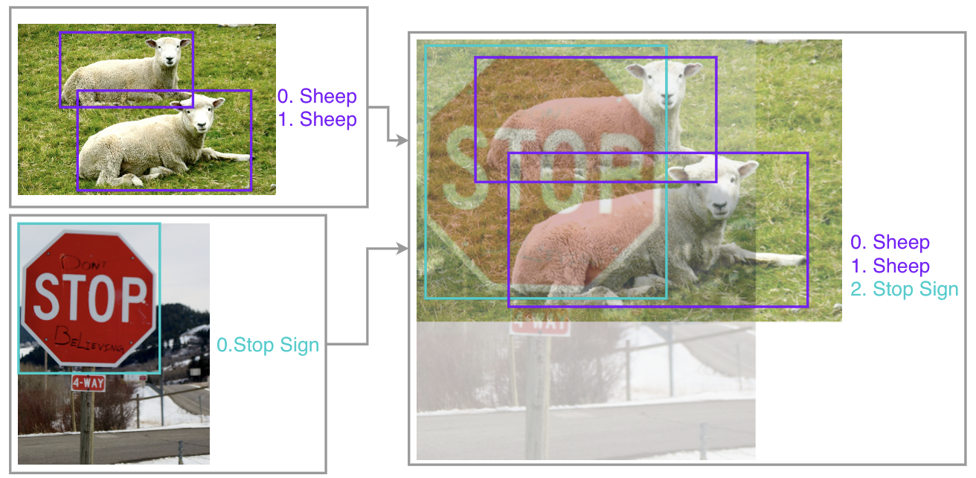
Advanced training approaches included in GluonCV
Mixup for object detection
Zhang, et al. "Bag of freebies for training object detection neural networks." arXiv preprint arXiv:1902.04103 (2019).

Slide 8
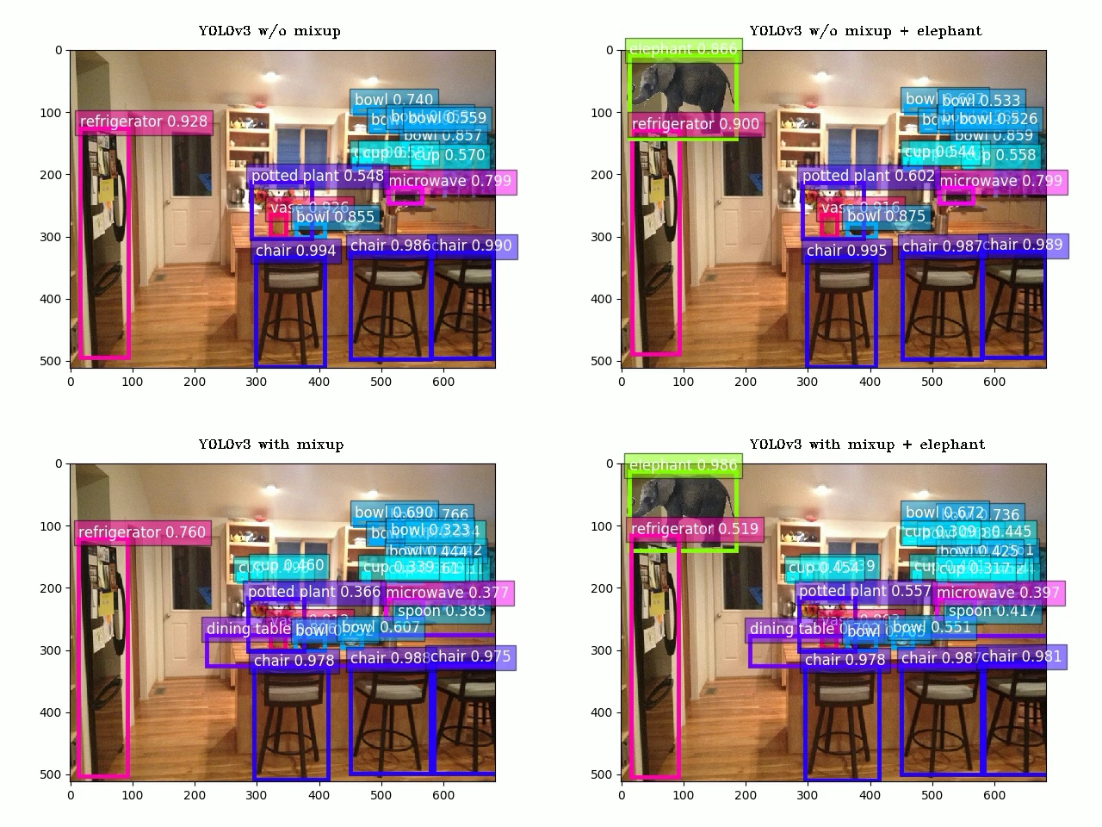
Advanced training approaches included in GluonCV
Mixup for object detection
Significantly improved robustness of models to unprecedented scenes
Zhang, et al. "Bag of freebies for training object detection neural networks." arXiv preprint arXiv:1902.04103 (2019).

Slide 9
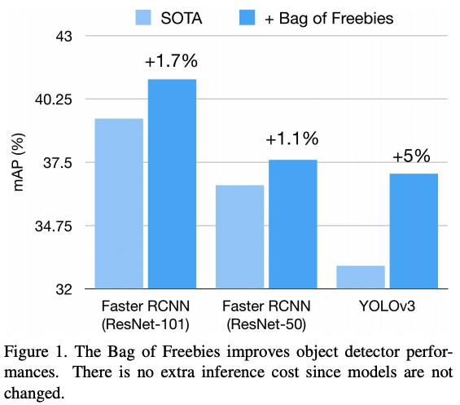
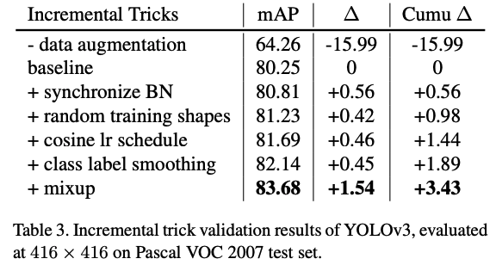
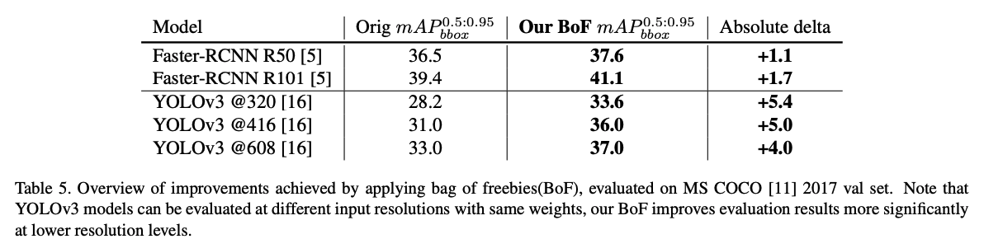
Advanced training approaches included in GluonCV

Slide 10
Hands On!

Slide 11

Like GluonCV? Go build!
https://github.com/dmlc/gluon-cv
https://gluon-cv.mxnet.io

